Slide 1

Flip-Robo Technology
Customer Retention Case Study

Slide 2

E-retail factors for customer activation and retention
Case Study From Indian E-Commerce Customers

Slide 3
Problem Statement
A case study from Indian e-commerce customers
Customer satisfaction has emerged as one of the most important factors that guarantee the success of online store; it has been posited as a key stimulant of purchase, repurchase intentions and customer loyalty. A comprehensive review of the literature, theories and models have been carried out to propose the models for customer activation and customer retention. Five major factors that contributed to the success of an e-commerce store have been identified as: service quality, system quality, information quality, trust and net benefit. The research furthermore investigated the factors that influence the online customers repeat purchase intention. The combination of both utilitarian value and hedonistic values are needed to affect the repeat purchase intention (loyalty) positively. The data is collected from the Indian online shoppers. Results indicate the e-retail success factors, which are very much critical for customer satisfaction.

Slide 4
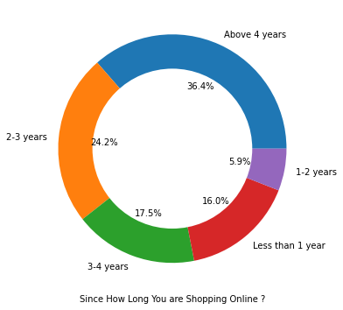
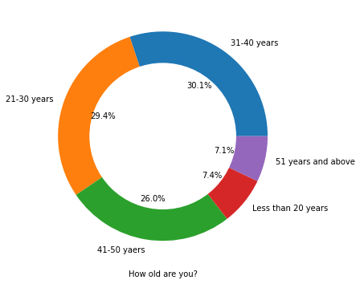
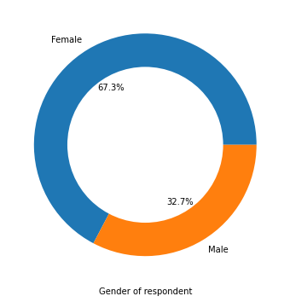
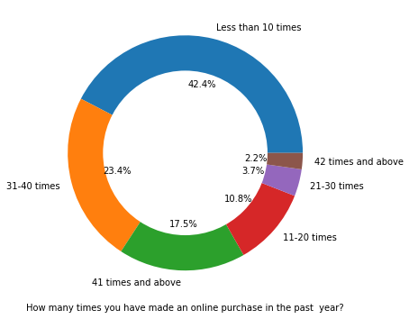
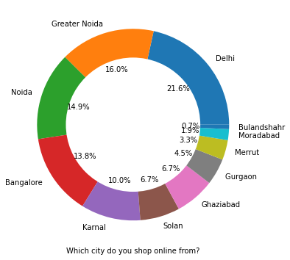
Personal Info
There is double the number of women than men who have taken this survey.
Most of the people are in their 30's followed by 20's, teenagers and senior citizen are the least in number.
Most of the people belong from delhi, noida and banglore, ambiguity can also be seen as noida has two categories (noida and grater noida) which need to be handled
Most of the people shopping online have been shopping from a long time.
Majority of people shop online 10 times a year, amiguity can also be seen for range 42 times and above which needs to be handled

Slide 5
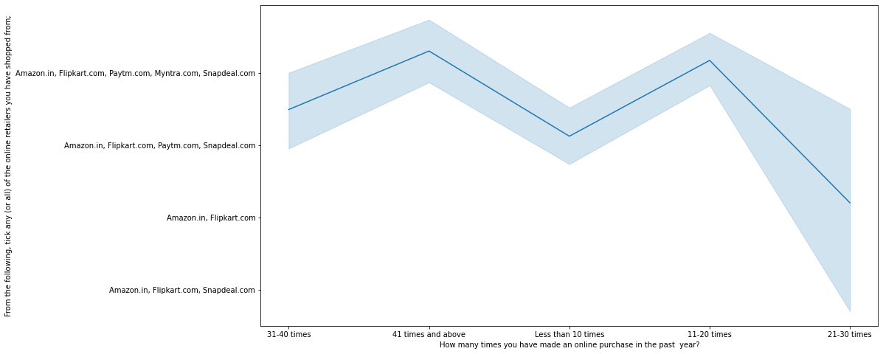
Intention of Repeat purchase
Heavy shoppers who shop more than 41 times a year shop from all the online brands, some of the people who shop for 32-40 and less than 10 times a year seem to exclude myntra . People shop from Amazon and flipkart whatever be the case.

Slide 6
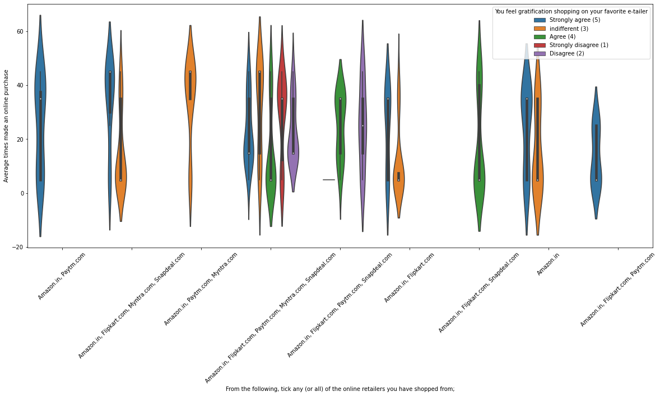
Comparing years for analysis
Almost all the people who have shopped from amazon, flipkart and paytm are satisfied. People who shop from a more number of online brands dosen’t seem to be satisfied.

Slide 7
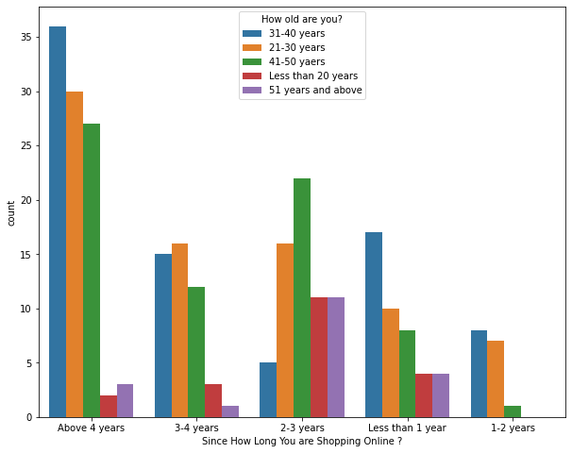
Online Retailing based on age
Highest number of people have been shopping online for above 4 years except for the age group below 20 years and above 50 years. People who are shopping online for 1-2 years does not include teenagers and elder people.

Slide 8
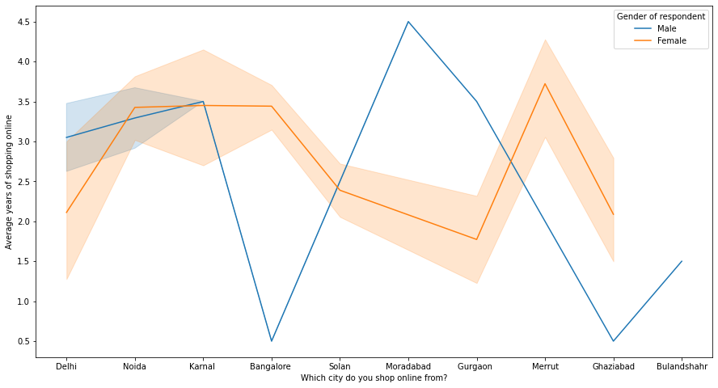
Density of customers in various cities
In lines, we can see that density of female customers is more than male. Men living in bangalore and ghaziabad shop have shopped online for less than 1 year. Highest number of men shopping online belong from delhi and noida, while men from moradabad have been shopping online for the longest. Women from meerut and noida have shopped the longest.

Slide 9
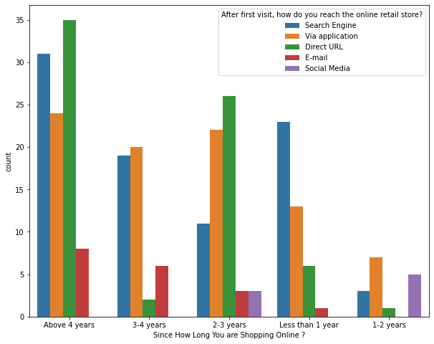
popular Platform
Even though people who are shopping online for more than 3 years do not use the application rather use search engine and direct url's in large number which indicates that online brands should update all their platforms rather than just application.

Slide 10
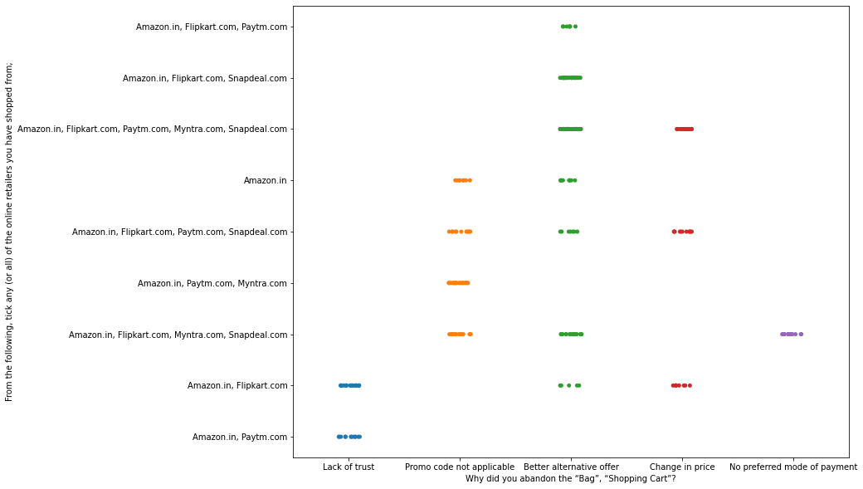
Reason to leave a platform
We can clearly see that most of the time people abandon the bag is beacuse they get a better alternative offer or promo code not applicable. There is also lack of trust seen in amazon, flipkart and paytm by some people.

Slide 11
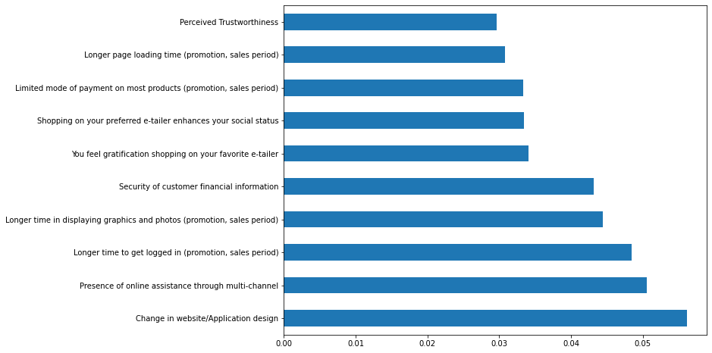
Features which affects the most for retaining customers

Slide 12

Thank you Roshan Kumar Verma

